Slide 1
Fashion Product
Group code : 27
Internal Guide : Dr. Dhara Bhatt
Ashutosh Dodia ( 16-BCA-082 B )
Jimil Patadia (16-BCA-106 B )
Milap Pathak ( 16-BCA-110 B )
External Guide : Mr. Savan Trivedi

Slide 2
INDEX
Company Profile
About Company
About Project
Requirement Gathering
Existing System
New System
Entities
Admin
Guest
Customer
Platform
DFD(Data Flow Diagram)
Data Dictionary
ERD

Slide 3
About Project
Fashion Product is a website which sells different types of fashion products.
Men and Women can select their desired products through many filters provided by website.

Slide 4
Existing System
Currently, customer have to order products by looking at the product images sent to them.
Product details is sent to them through messages.
Searching products is time wasting job.
Customer will not be able to check order status.
Customers will not be able to view various offers on products.
There is no Invoice Bill system.

Slide 5
Requirement Gathering
The website will be easy to use, reliable and cost saving.
Customers can share product detail.
Providing easy and faster selection of products through many filters.
Features such as wish list and cart will be available.
Providing easy buying facility and generating Invoice.

Slide 6
New System
Customer will be able to login.
Customer will be able to place order online.
Customer will be able to search desired product through filters.
Product rating and reviews will be shown.
Bill invoice will be sent through email as well as with product.
Customer can also view their previous invoice.
Customer can provide Feedback.

Slide 7
Entities
Admin
Guest
Customer

Slide 8
Admin
Admin can login with username and password.
Admin can manage product details.
Admin can update product information.
Admin can Add/Remove any product.
Admin can manage product order.
Admin can manage feedback details.

Slide 9
Guest
Guest can view product details.

Slide 10
Customer
Customer can login with e-mail or phone number.
Customer can search category of products
Customer can add/remove products from wish list.
Customer can add products in the cart to purchase it.
Customer can view their order status.
Customer can share product information.
Customer can give feedback.

Slide 11




Platform
Front End : PhP 5.6
Back End : My SQL 5.5
Server : XAMPP
IDE : Netbeans 8.1
Other Tools : MS Office 2007, MS VISIO 2007

Slide 12
DFD(Data Flow Diagram)
Context Level

Slide 13
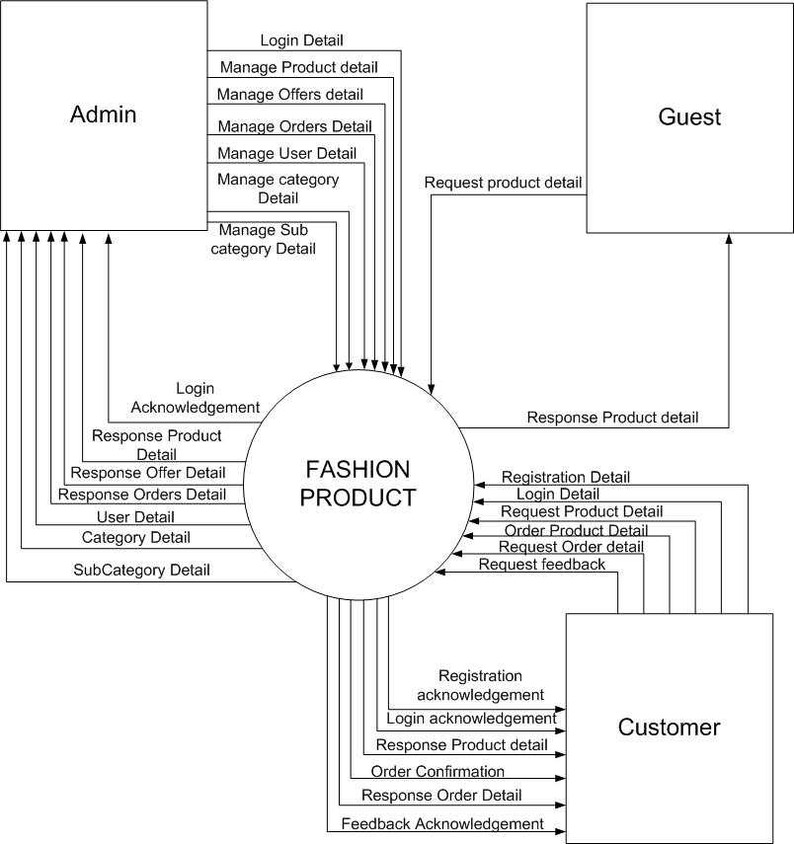

Slide 14
Level 1

Slide 15
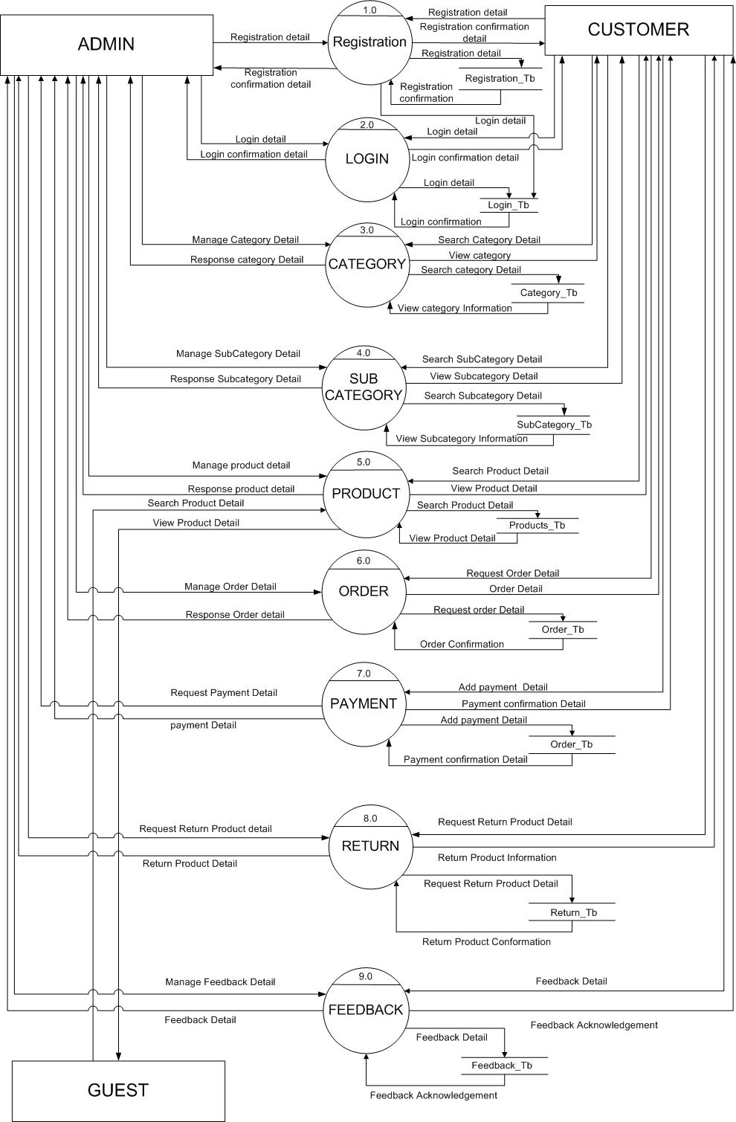
+

Slide 16
Level 2 (2.2 Login)

Slide 17
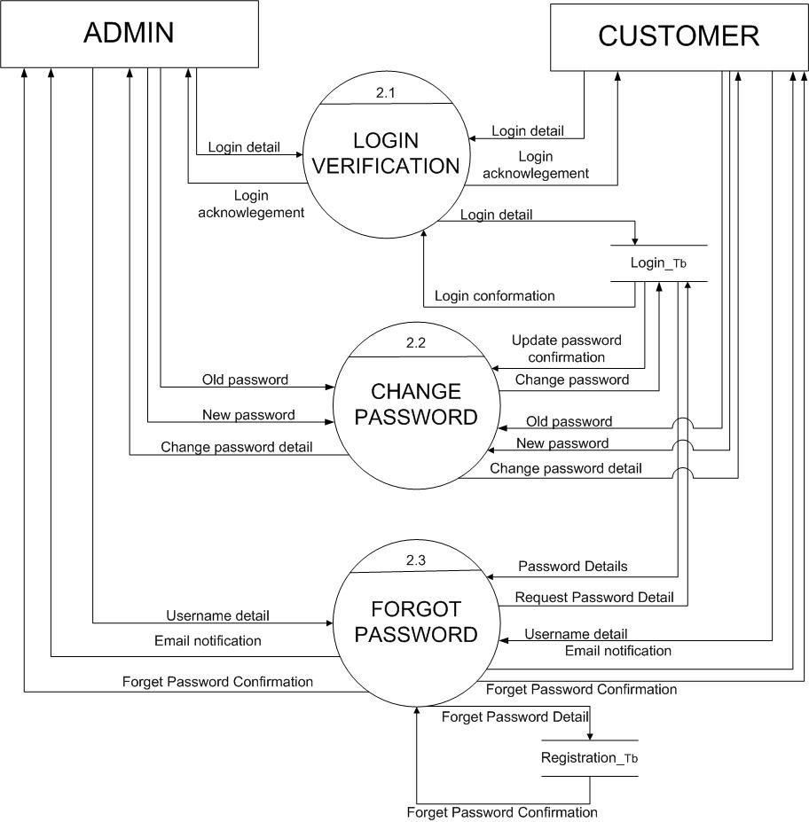

Slide 18
Level 2 (2.3 Category)

Slide 19
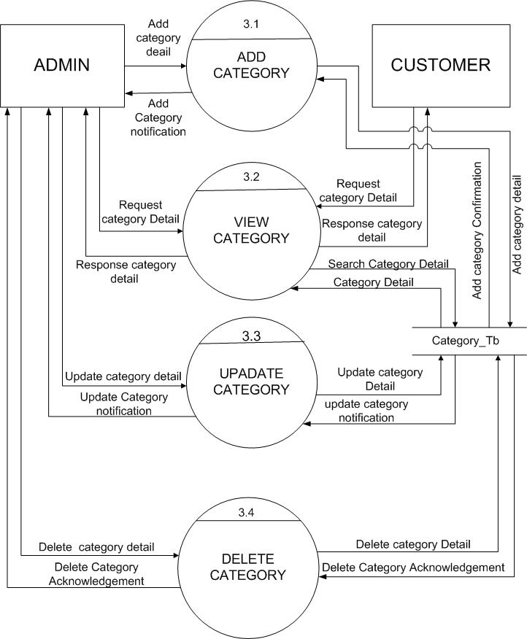

Slide 20
Level 2 (2.4 Sub Category)

Slide 21
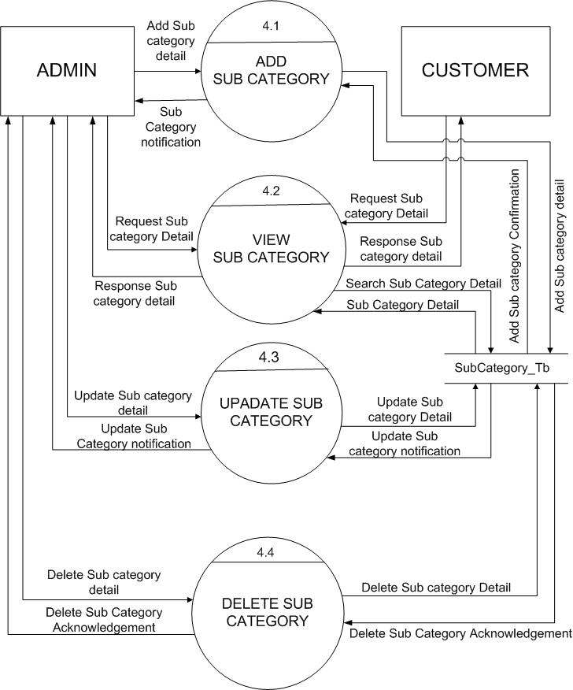

Slide 22
Level 2 (2.5 Product)

Slide 23
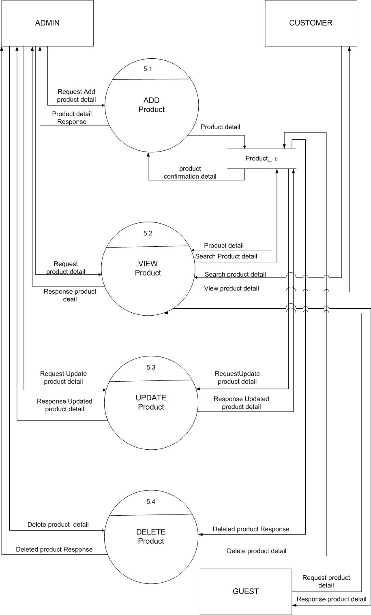

Slide 24
Level 2 (2.6 Order)

Slide 25
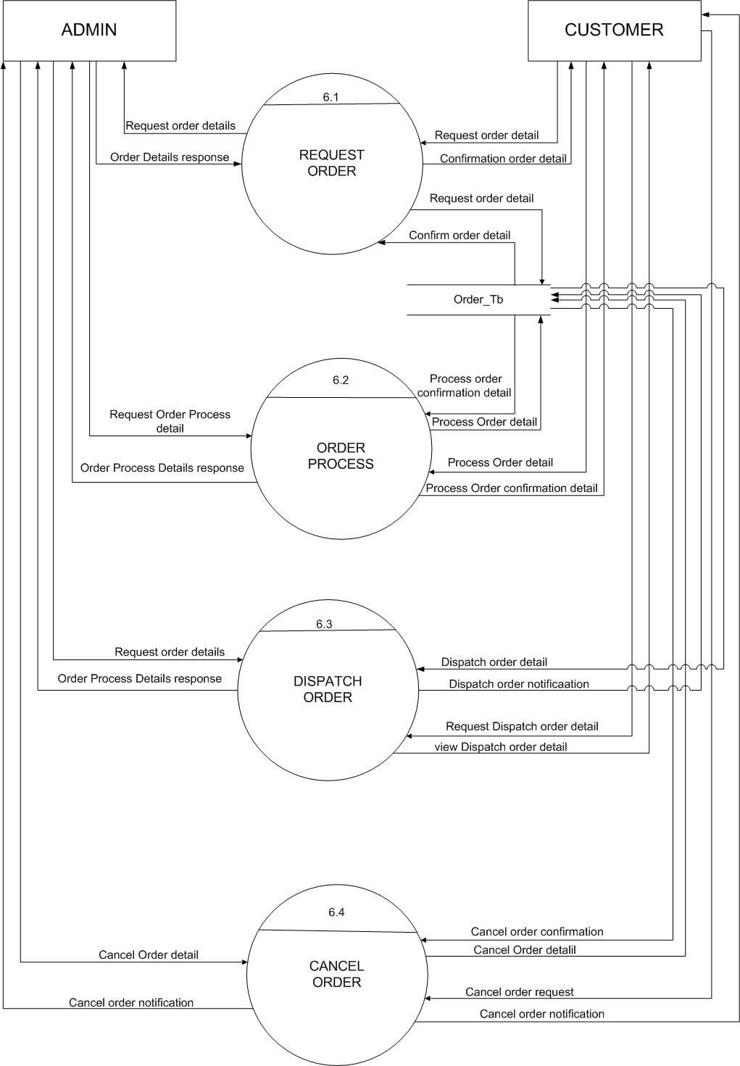

Slide 26
Level 2 (2.8 Return)

Slide 27
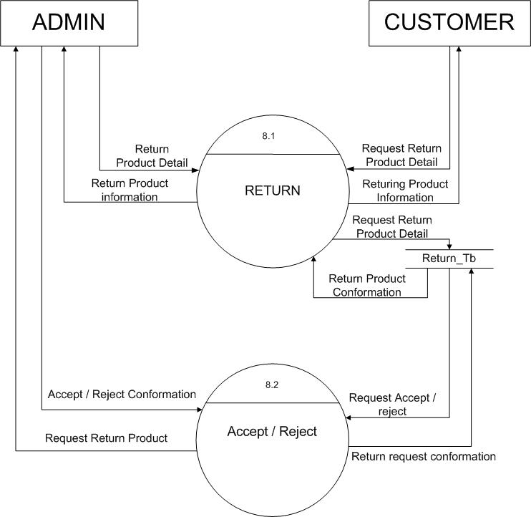

Slide 28
Level 2 (2.9 Feedback)

Slide 29
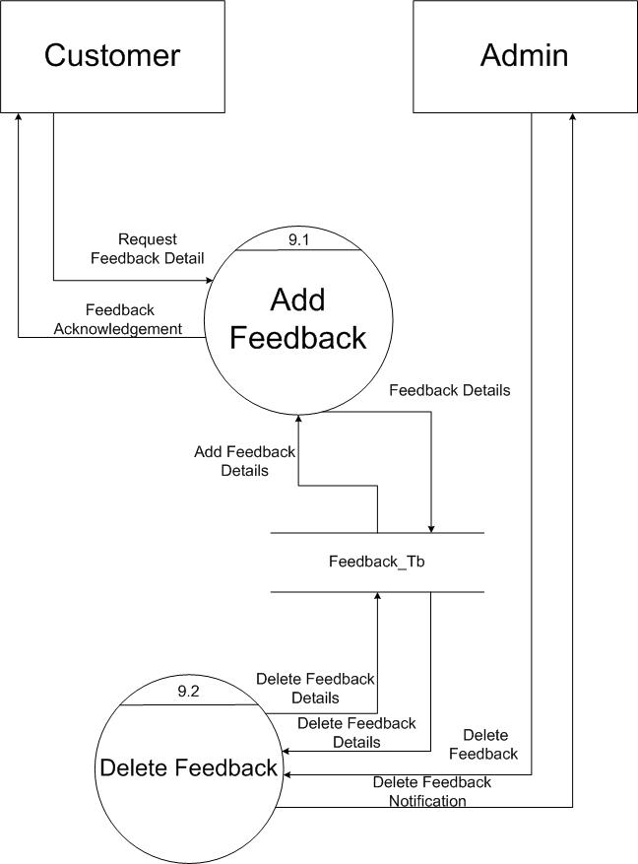

Slide 30
Data Dictionary

Slide 31
Table Name : User_Tb Description : All the details of User
Field Name | Data Type | Size | Constraint | Description
User_Id | Integer | 6 | Primary key | It will store the id of User
Name | Varchar | 20 | Not Null | It will store the name of User
Date_of_Birth | Date |  | Not Null | It will store the date of birth of User
Address | Varchar | 160 | Not Null | It will store the address of User
Email_Id | Varchar | 25 | Not Null, Unique | It will store the email id of User
Password | Varchar | 15 | Not null | It will store the password of User
Gender | Bit |  | Not Null | It will store the gender of User. 0 is Male and 1 is Female
Mobile_Number | Integer | 10 | Not Null, Unique | It will store the User’s Mobile Number
IsAdmin | Boolean |  | Not Null | It will store if User is admin or Customer. True is Admin and False is Customer

Slide 32
Table Name : Category_TB Description : It will store All the details of Category Table
Fieldname | DataType | Size | Constraint | Description
Category_Id | Integer | 6 | Primary key | It will store the unique id of category
Category_Name | Varchar | 30 | Unique | It will store the category name
IsVisible | Boolean |  | Not Null | It will store where Category is Visible or not.

Slide 33
Table Name : SubCategory_TB Description : All the details of Sub Category
Fieldname | Data Type | Size | Constraint | Description
SubCategory_Id | Integer | 6 | Primary key | It will store the unique id of SubCategory
Category_Id | Integer | 6 | Foreign key | This constraint joins Category table and SubCategory
SubCategory_name | Varchar | 25 | Unique | It will store the SubCategory name of product
IsVisible | Boolean |  | Not Null | It will store whether SubCategory is Visible or not.

Slide 34
Table Name : Product_TB Description : It will store all details of products
Field Name | DataType | Size | Constraint | Description
Product_Id | Integer | 6 | Primary key | It will store the Id of Product
SubCategory_Id | Integer | 6 | Foreign Key | This constraint joins Sub Category table and Product
Product_Name | Varchar | 30 | Unique ,Not Null | It will store the name of Product
Product_Detail | Text |  | Not null | It will store the description of Product
Price | Decimal | (4,2) | Not Null | It will store price of the product
Quantity | Integer | 3 | Not Null | It will store the quantity of the product
IsVisible | Boolean |  | Not Null | It will store where Product is Visible or not.
Size_id | Integer | 6 | Not Null | It will store the size of the product
Color_id | Integer | 6 | Not Null | It will store the color of the product

Slide 35
Table Name : Size_TB Description : It will store size of The Product
Fieldname | Data Type | Size | Constraint | Description
Size_Id | Integer | 6 | Primary key | It will store the id of the product
Size | varchar | 5 | Not null | It will store the size of the product

Slide 36
Table Name : Color_TB Description : It will store Color of The Product
Fieldname | Data Type | Size | Constraint | Description
Color_Id | Integer | 6 | Primary key | It will store the id of the product
Color | Varchar | 10 | Not null | It will store the Color of the product

Slide 37
Table Name : ProductImage_TB Description : It will store All the images of the product
FieldName | DataType | Size | Constraint | Description
ProductImage_Id | Integer | 6 | Primary key | It will store the unique id of Product Image
Product_Id | Integer | 6 | Foreign Key | This constraint joins Product table and ProductImage
ImagePath | Varchar | 100 | Not Null | It will store the path of image file.

Slide 38
Table Name : Order_TB Description : It will store all the Ordered Detail
FieldName | DataType | Size | Constraint | Description
Order_Id | Integer | 6 | Primary key | It will store the unique id of Order
User_Id | Integer | 6 | Foreign Key | This constraint joins OrderMaster table and User Table.
Order_Date | Date |  | Not Null | This will store the Date when Order Placed.
Order_Status | Varchar | 15 | Not Null | It will store the status of the Order. i.e. Pending or Delivered
Method | Varchar | 10 | Not null | It will store the method of payment. i.e. COD or Paytm
Transaction No. | Varchar | 12 | Not Null | It will store the Transaction Number.
Payment_date | Date |  | Not null | It will store the date of payment.
Payment_ Status | Varchar | 15 | Not Null | It will store the Payment Status. i.e. Paid or Pending

Slide 39
Table Name : OrderDetail_TB Description : It will store all the Order Detail
FieldName | DataType | Size | Constraint | Description
OrderDetail_Id | Integer | 6 | Primary key | It will store the unique id of Order Detail Table
Order_Id | Integer | 6 | Foreign Key | This constraint joins Order Detail table and OrderMaster Table.
Product_Id | Integer | 6 | Foreign Key | This constraint joins Order Detail table and Product Table.
Quantity | Integer | 2 | Not Null | It will store the total number of products ordered.
Amount | Decimal | (4,2) | Not Null | It will store the amount of the order.

Slide 40
Table Name : Feedback_TB Description : All the details of feedback
Field Name | DataType | Size | Constraint | Description
Feedback_Id | Integer | 6 | Primary key | It will store the unique id of feedback
Product_Id | Integer | 6 | Foreign Key | This constraint joins Feedback Table and Product Table.
Feedback_Date | Date |  | Not Null | It will store the date of feedback
Details | Text |  | Not Null | It will store the details of feedback
IsVisible | Boolean |  | Not Null | It will store where Feedback is Visible or not.

Slide 41
Table Name : OrderReturn_TB Description : It will store the Order Return Details
FieldName | Data Type | Size | Constraint | Description
OrderReturn_Id | Integer | 6 | Primary Key | It will store the unique id of Return Order
Order_Id | Integer | 6 | Foreign Key | This constraint joins OrderReturn table and Order Table.
Date | Date |  | Not Null | It will store the return date of order

Slide 42
Table Name : OrderReturnDetail_TB Description : It will store the Order Return Details
FieldName | DataType | Size | Constraint | Description
OrderReturnDetail_Id | Integer | 6 | Primary Key | It will store the unique id of Returned Order Details.
OrderReturn_Id | Integer | 6 | Foreign Key | This constraint joins OrderReturnDetail table and OrderReturn Table.
Product_Id | Integer | 6 | Foreign Key | This constraint joins Product table and OrderReturnDetail Table.
Note | Text |  | Not Null | It will store the reason for returning the order.
Quantity | Integer | 2 | Not Null | It will store the quantity of Return Product.
Amount | Decimal | (4,2) | Not null | It will store the amount of Order.

Slide 43
Table Name : DeliveryDetail_TB Description : It will store the Delivery Details
FieldName | DataType | Size | Constraint | Description
Delivery_Id | Integer | 6 | Primary Key | It will store the unique id of Delivery .
Order_Id | Integer | 6 | Foreign Key | This constraint joins Order table and Delivery Detail Table.
Name | Varchar | 25 | Foreign Key | It will store the Customer Name.
Mobile | Integer | 10 | Not Null | It will store the Mobile Number.
Address | Varchar | 160 | Not Null | It will store the address of the customer.
Status | Varchar | 10 | Not null | It will store the status of the Delivery.

Slide 44
ERD

Slide 45
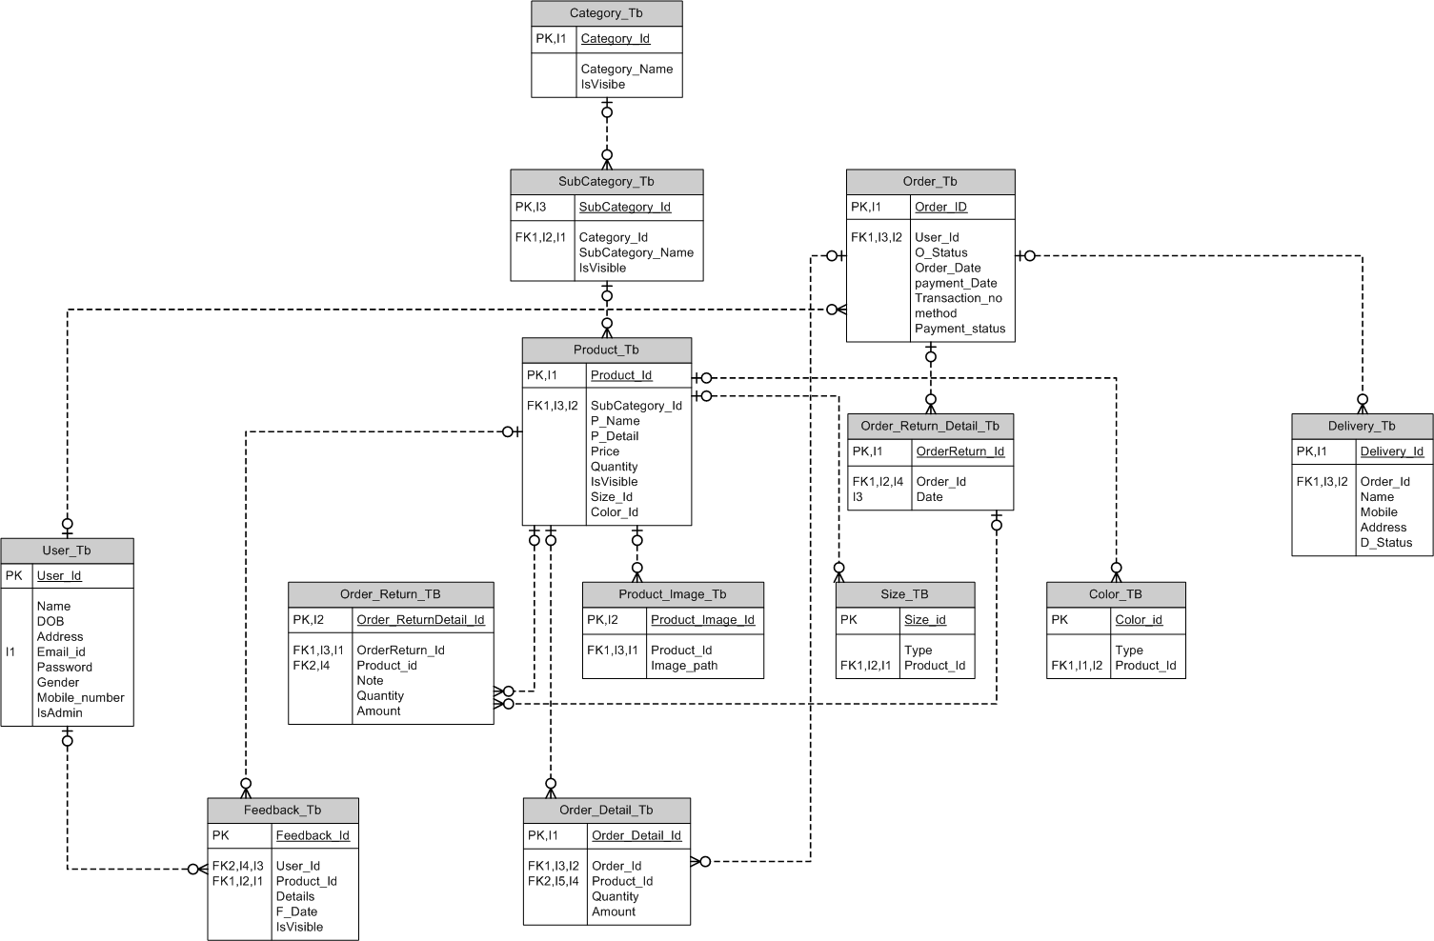

Slide 46


